Slide 1

Automated Surface Defect Detection and Quality Inspection for Steel and Metal Production using Computer Vision
PRESENTED BY:
Partha Sarathi T(192325042) Surya Kiran(192325057) S. Firoz(192312323) Lenin A(192411232) GUIDED BY:
Program Director : Dr. Sasi Rekha, Prof/CSE Faculty:- Mrs.R C Jeni Gracia, AP / CSE

Slide 2


INTRODUCTION
Steel and metal production requires reliable surface quality inspection.
Computer vision enables automated detection of cracks, scratches, dents, rust and other surface defects.
Manual inspection is time-consuming and can miss small or complex defects.
Image processing and deep learning can analyze products consistently in real time.
The proposed system supports faster, accurate and automated quality inspection.

Slide 3
PROBLEM STATEMENT
Manual surface inspection is labor-intensive and subjective.
Small defects may be missed during high-speed production.
Different lighting and surface conditions affect inspection accuracy.
Defect detection must operate quickly without interrupting production.
Manufacturers need an intelligent system for consistent quality decisions.
A computer-vision-based automated inspection solution is required.

Slide 4
OBJECTIVES
Detect surface defects in steel and metal products automatically.
Capture high-quality images/video from the production line.
Identify products and localize visible defects.
Classify products as defective or non-defective.
Provide consistent quality decisions with reduced manual effort.
Support real-time monitoring and quality improvement.

Slide 5
LITERATURE SURVEY
.
Authors & Year | Paper Title | Merits | Demerits
Huang et al., 2023 | Deep Learning for Telecom Churn Prediction | High prediction accuracy | Requires large datasets
Ahmed et al., 2024 | Customer Churn Prediction using DNN | Learns complex customer behavior | Longer training time
Kim et al., 2023 | Neural Networks for Customer Analytics | Better feature extraction | High computational cost
Zhang et al., 2024 | AI-based Churn Prediction | Improved customer retention | Needs continuous model updates
Singh et al., 2024 | Telecom Customer Churn Analysis | Effective classification | Sensitive to data imbalance

Slide 6
TOOLS & TECHNOLOGIES USED
Development Tools
Python
Google Colab / Jupyter Notebook
Libraries
OpenCV
NumPy
Pandas
Matplotlib
Deep Learning
TensorFlow / Keras
CNN / Object Detection Model
Dataset & Visualization
Steel/Metal Surface Defect Images
Training, validation and test datasets

Slide 7
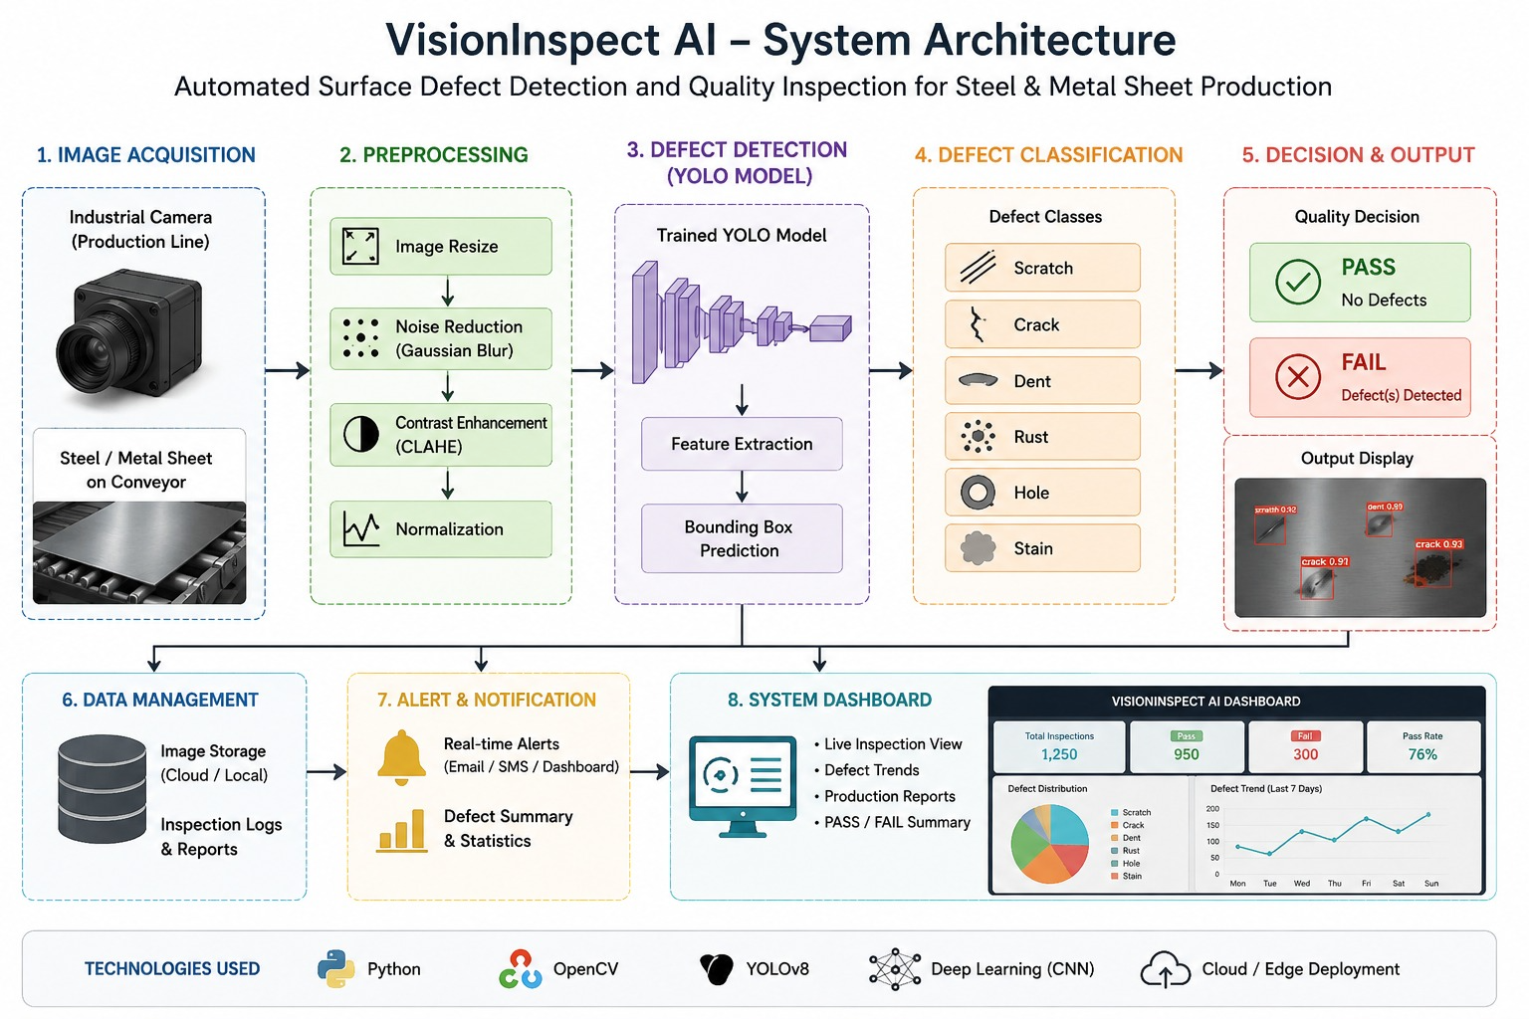
System architecture

Slide 8
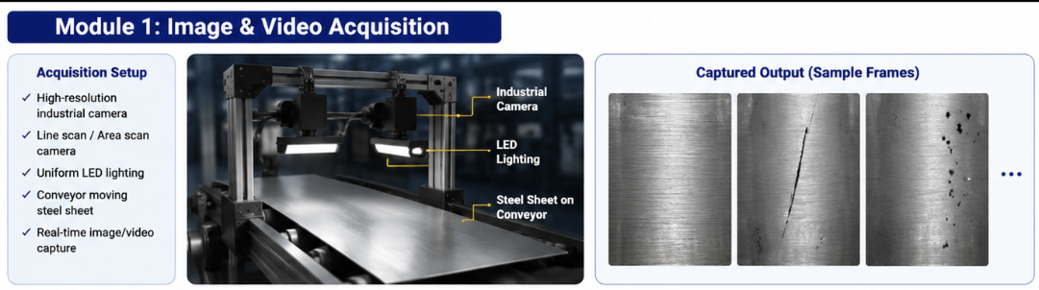
MODULE 1: IMAGE & VIDEO ACQUISITION
Objective
Capture clear images or video frames of steel and metal products from the production line.
Process
• Acquire images using industrial/line-scan cameras.
• Extract video frames when continuous video is used.
• Resize images to the model input size.
• Apply noise reduction and image enhancement.
• Normalize pixel values for consistent processing.
Output
Preprocessed product images/frames ready for detection.

Slide 9
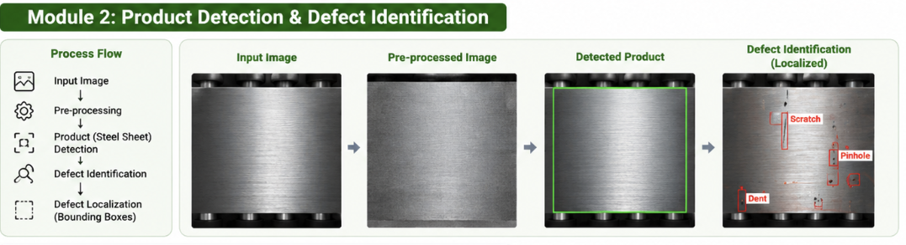
MODULE 2: PRODUCT DETECTION & DEFECT IDENTIFICATION
Objective
Locate the product and identify visible surface defects.
Process
• Detect the steel/metal product region.
• Extract relevant surface regions for inspection.
• Apply CNN/object-detection techniques to learn defect features.
• Identify defects such as cracks, scratches, dents, rust or surface marks.
• Generate defect location/class labels with confidence scores.
Output
Detected product with identified defect regions and labels.

Slide 10
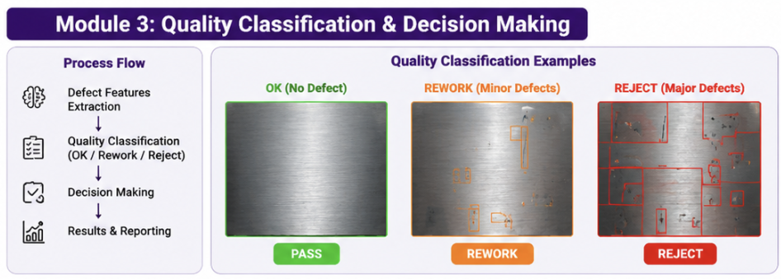
MODULE 3:
QUALITY CLASSIFICATION & DECISION MAKING
Objective
Convert defect detection results into an automated quality decision.
Process
• Analyze detected defect type, location and confidence.
• Compare results with predefined quality criteria.
• Classify the product as PASS / ACCEPTED or FAIL / DEFECTIVE.
• Record inspection results and defect information.
• Provide alerts for defective products when required.
Output
Automated quality decision for each inspected product.

Slide 11
RESULTS & DISCUSSION
Accurate defect detection – Surface defects such as scratches, dents, and pinholes were identified from captured images.
Effective image acquisition – Industrial cameras and proper lighting provided clear images for inspection.
Reliable defect localization – Detected defects were localized using bounding boxes.
Quality classification – Products were classified into OK, Rework, or Reject based on defect severity.
Reduced manual inspection – Computer vision enables faster and more consistent quality inspection.
Real-time decision making – The system supports quick production decisions and helps reduce defective products reaching customers.

Slide 12
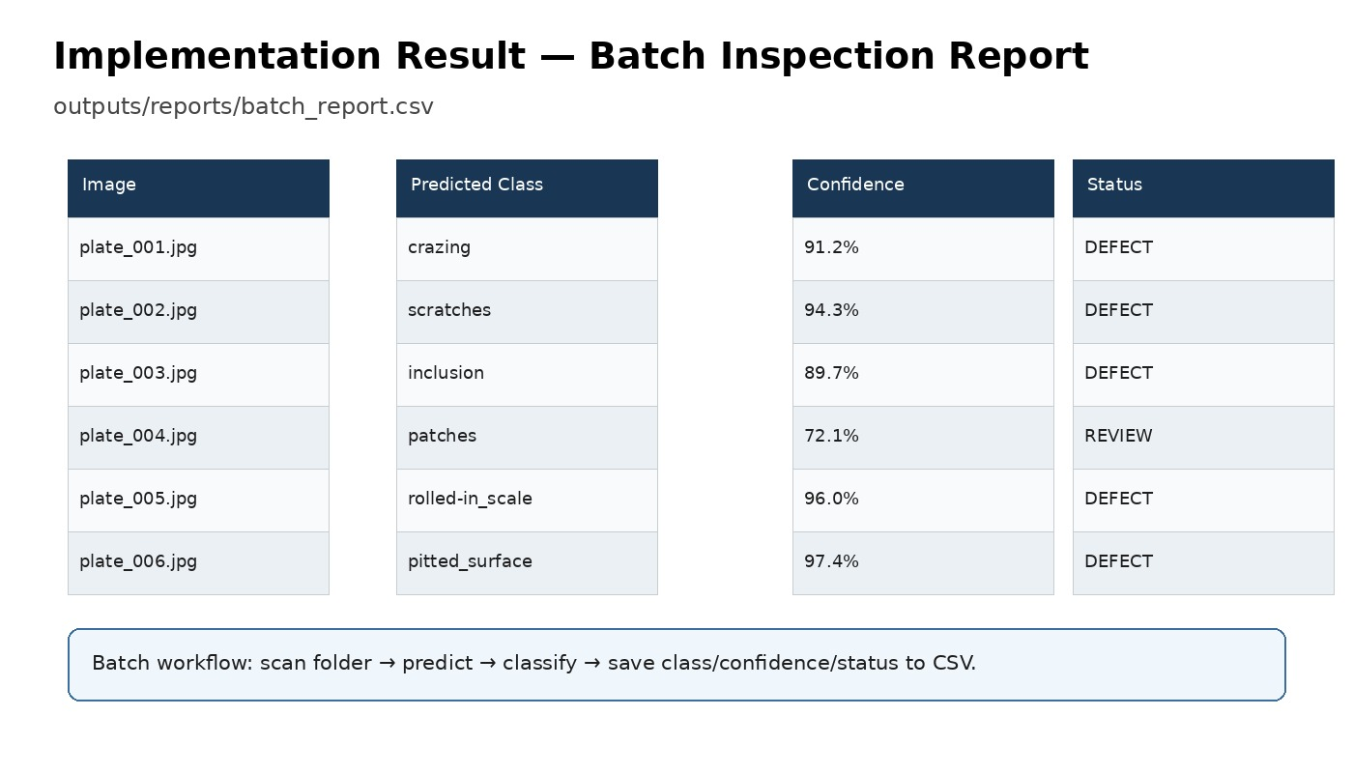

Slide 13
FUTURE ENHANCEMENTS
Real-time inspection – Implement faster processing for continuous production-line monitoring.
Advanced AI models – Use YOLO, CNN, or Transformer-based models for improved defect detection.
More defect types – Extend the system to identify cracks, corrosion, stains, and other surface defects.
Automated production control – Integrate the system with robotic sorting and rejection mechanisms.
Cloud-based monitoring – Store inspection results in the cloud for analytics, reporting, and remote monitoring.

Slide 14
CONCLUSION
Automated computer vision enables efficient surface defect inspection of steel and metal products.
The system captures high-quality images and videos for reliable inspection.
Defects such as scratches, dents, and pinholes can be detected and localized automatically.
Products are classified as OK, Rework, or Reject based on defect severity.
The proposed system improves inspection speed, consistency, and overall product quality.

Slide 15
THANK YOU

